Slide 1
Intro to Reinforcement Learning
NUIEEE
Quan Do

Slide 2

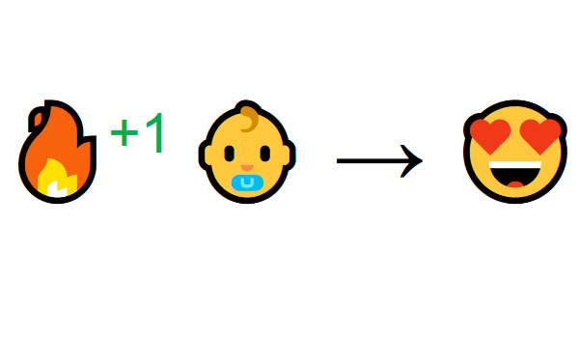
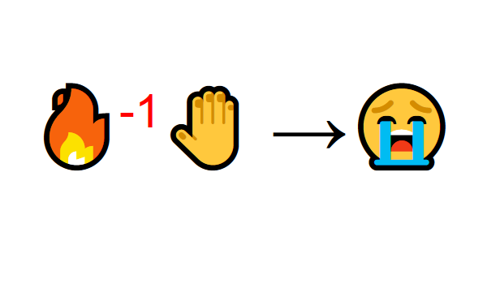
What is Reinforcement Learning?

Slide 3
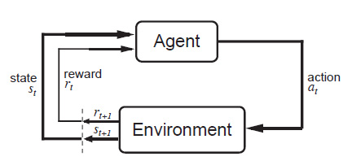
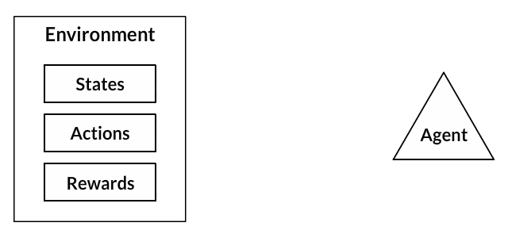
Formalities
Our Agent receives state S0 from the Environment (baby sees fire)
Based on that state S0, agent takes an action A0 (baby will move closer)
Environment transitions to a new state S1 (fire is closer)
Environment gives some reward R1 to the agent (not dead and warm: +1)
This RL loop outputs a sequence of state, action and reward.

Slide 4
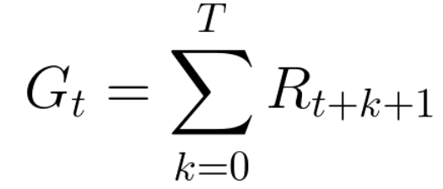
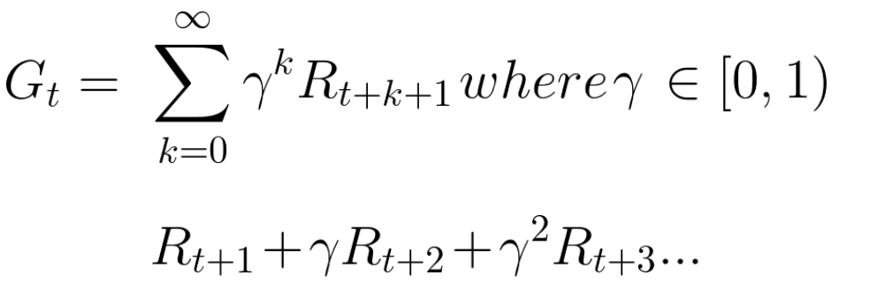
Goals
Maximize the expected cumulative reward (Utilitarianism)
But reward has to be discounted (Delayed Gratification/Marshmallow Test)
The larger the gamma, the smaller the discount. Agents care more about long time reward.

Slide 5
Learning
Monte Carlo Approach:
Collect the rewards at the end and calculate the maximum expected future reward.
Temporal Difference Learning:
Estimate the rewards at each step.

Slide 6
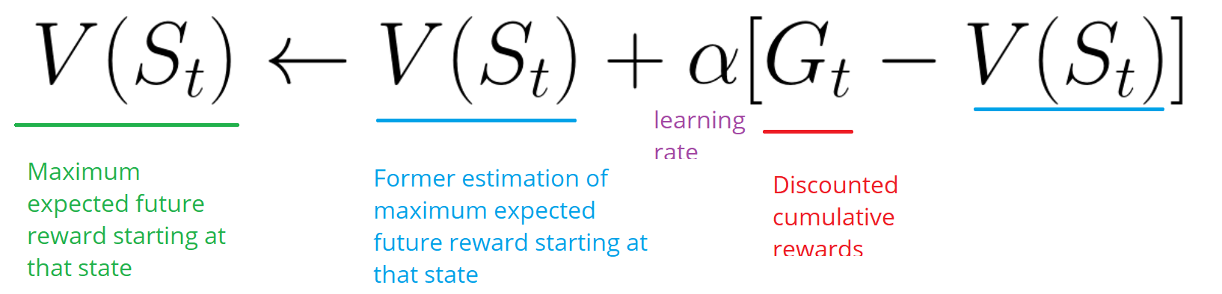
Monte Carlo Approach
When the episode ends (the agent reaches a “terminal state”), the agent looks at the total cumulative reward to see how well it did. In Monte Carlo approach, rewards are only received at the end of the game.

Slide 7
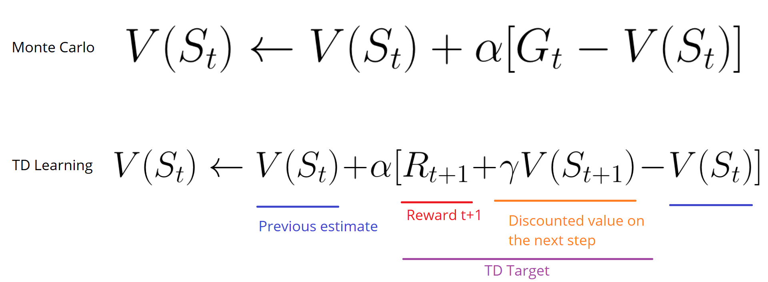
Temporal Difference Learning
It will update its value estimation V for the non-terminal states St occurring at that experience.

Slide 8
Value Function
The value function is a function that tells us the maximum expected future reward the agent will get at each state.

Slide 9
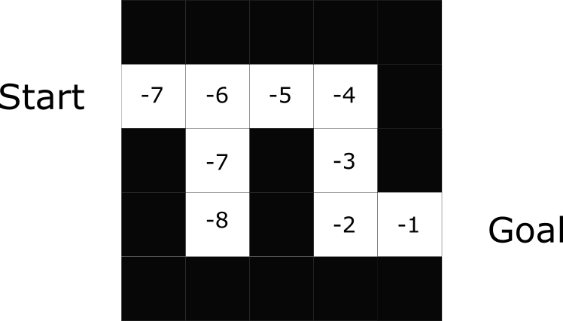
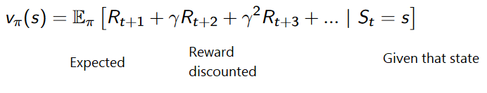
Optimization Strategies
Value-based (Q-Learning, Deep Q Learning)
In value-based RL, the goal is to optimize the value function V(s).
Q Value given a state s

Slide 10
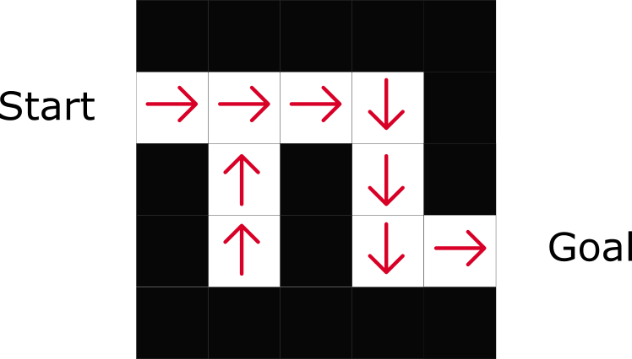
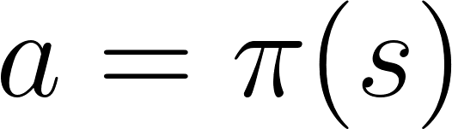
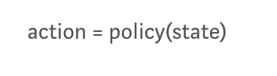
Optimization Strategies
Policy Based (Policy Gradient, Proximal Policy Gradient)
In policy-based RL, we want to directly optimize the policy function π(s)without using a value function.
The policy defines the agent behavior at a given time

Slide 11
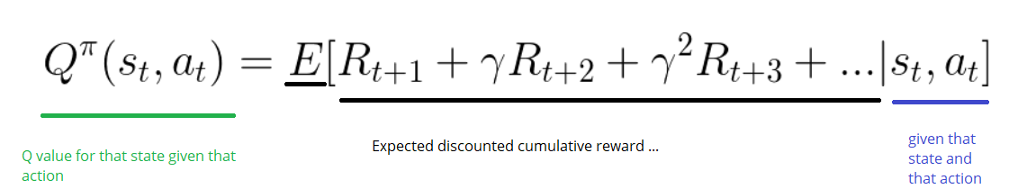
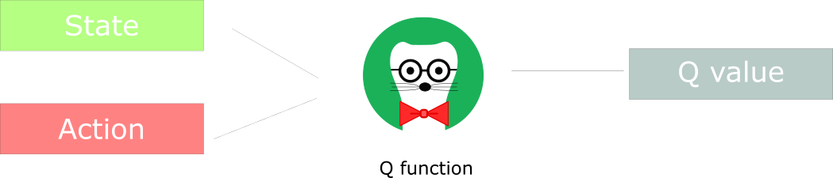
Q Learning
It’s a Value-based Learning, TD-Learning based algorithm.

Slide 12
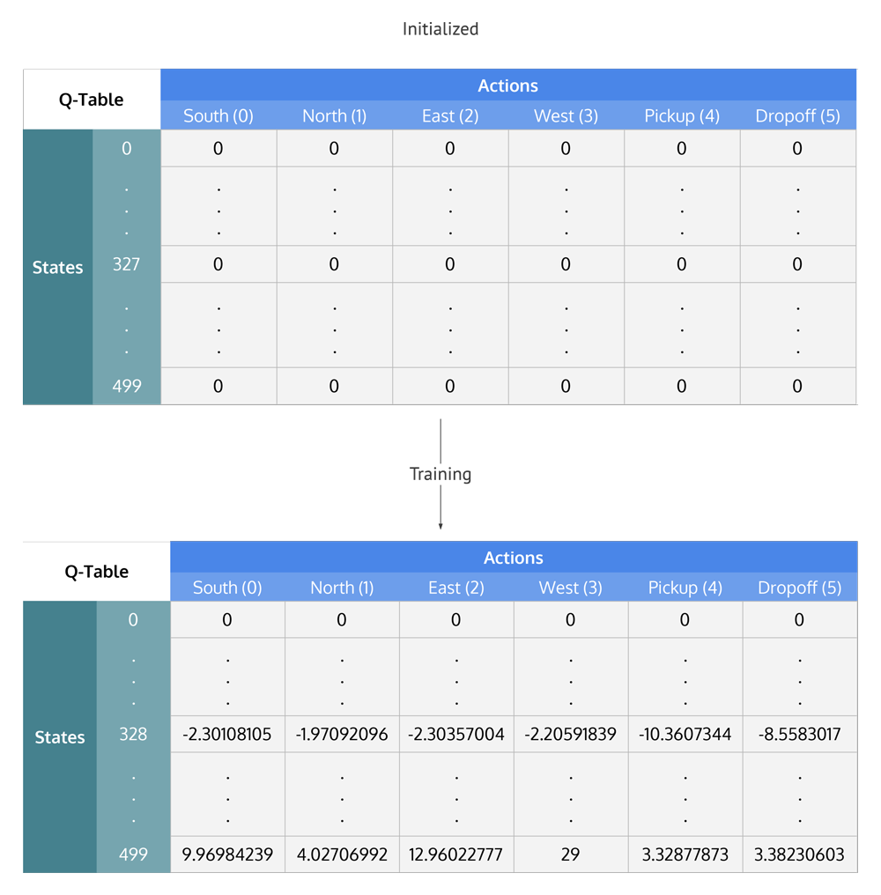
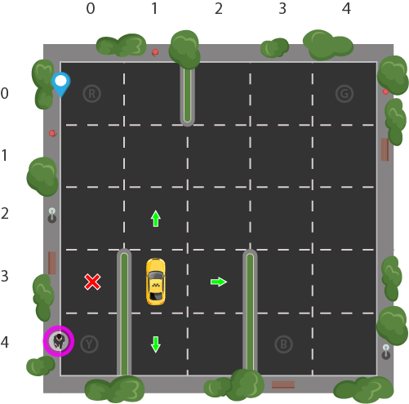
Q-Table

Slide 13
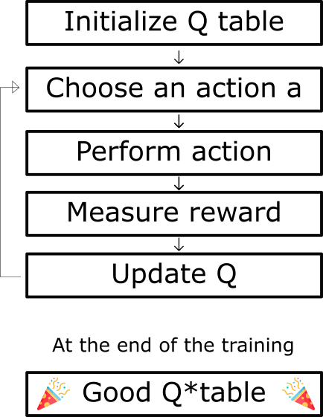
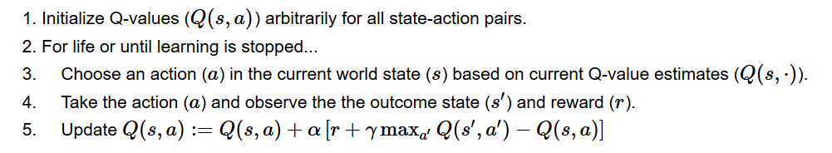
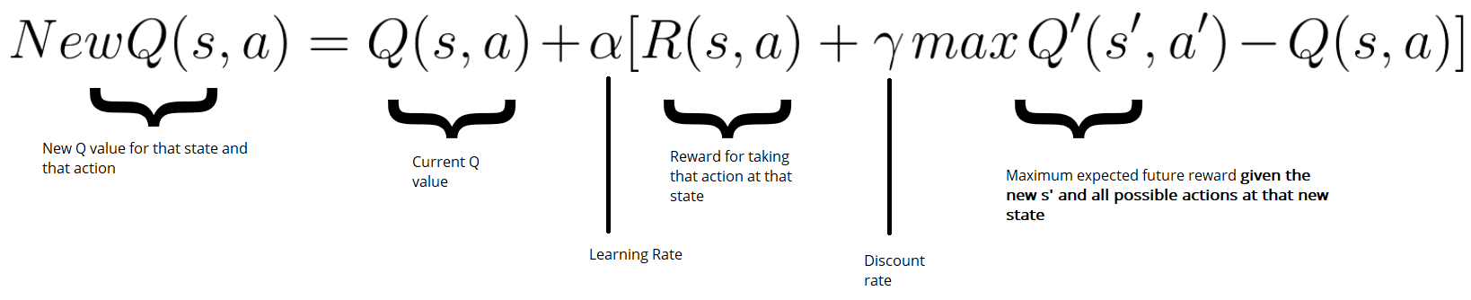
Algorithm
New Q value = Current Q value + lr * [Reward + discount_rate * (highest Q value between possible actions from the new state s’ ) — Current Q value ]

Slide 14
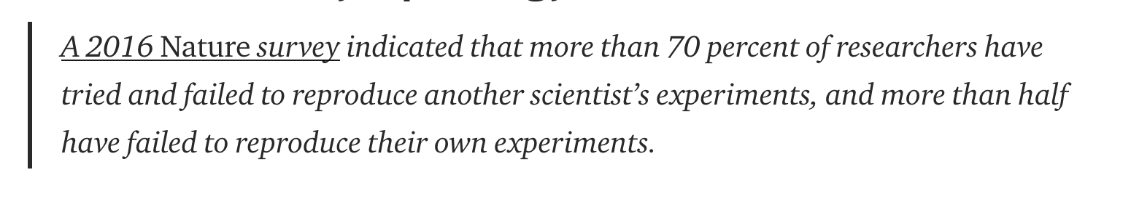
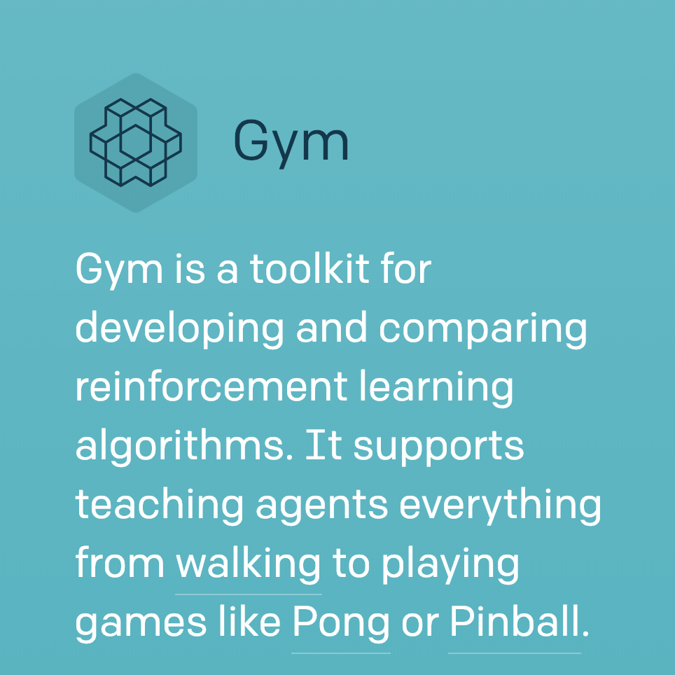
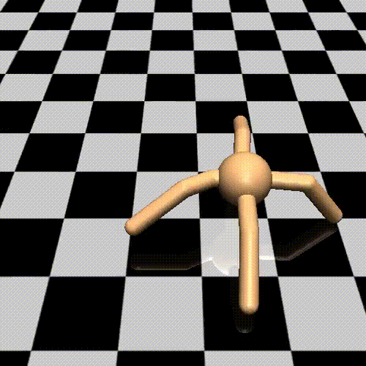

OpenAI Gym

Slide 15


Jupyter Notebook
https://jupyter.org/
conda create -n mypython3 python=3 source activate mypython3
pip install ipykernel
ipython kernelspec install-self
jupyter kernelspec list

Slide 16
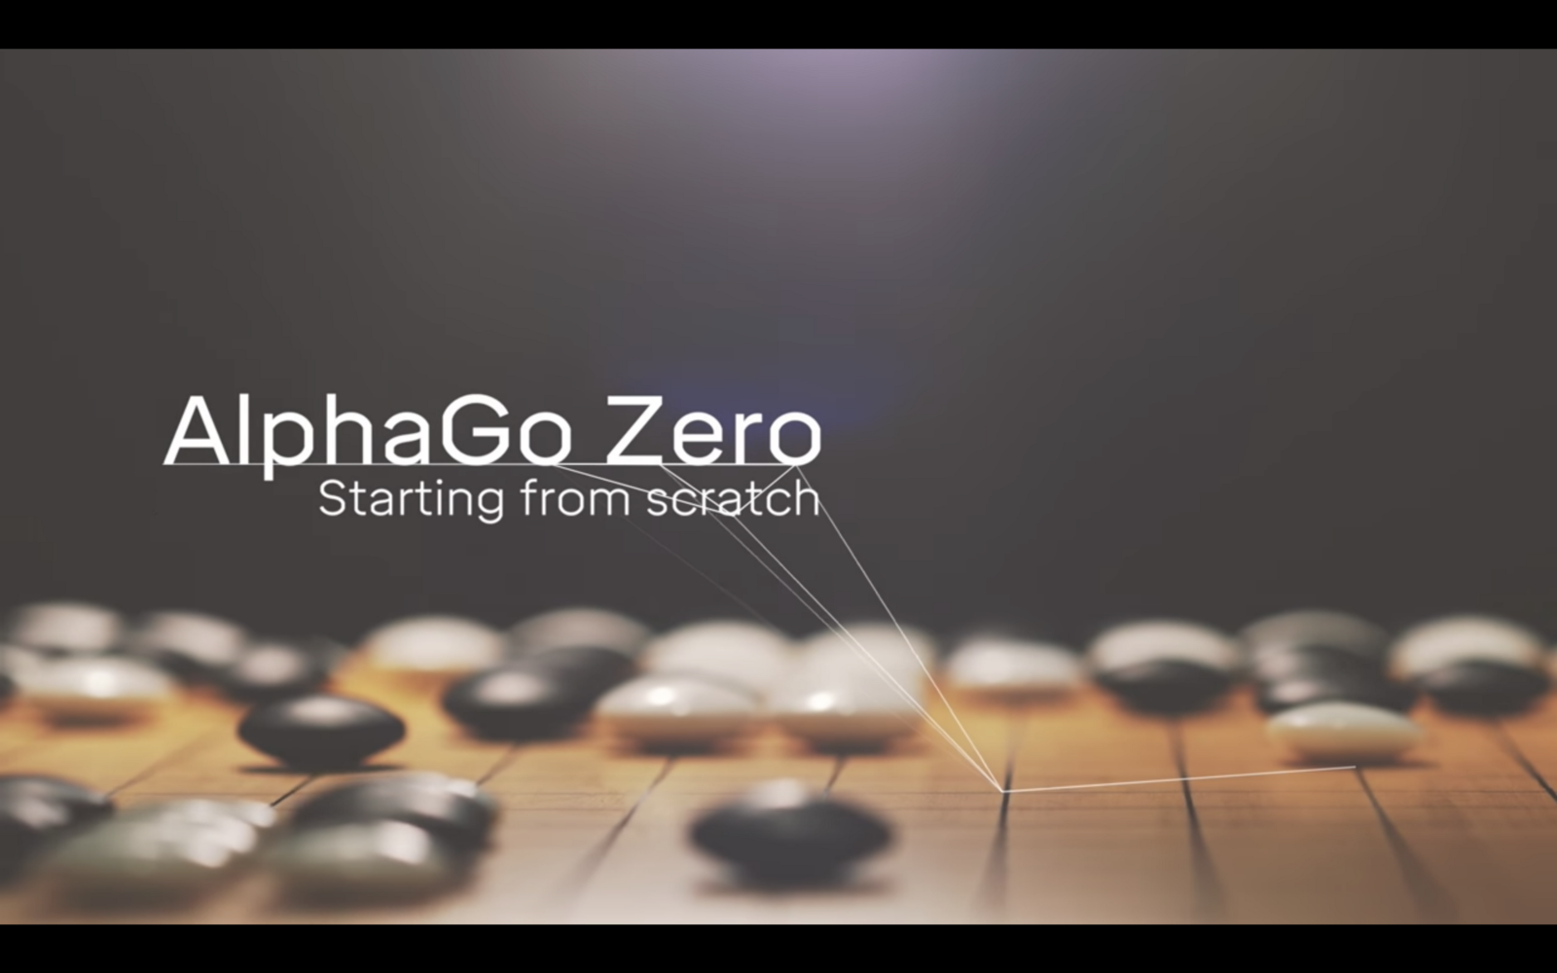
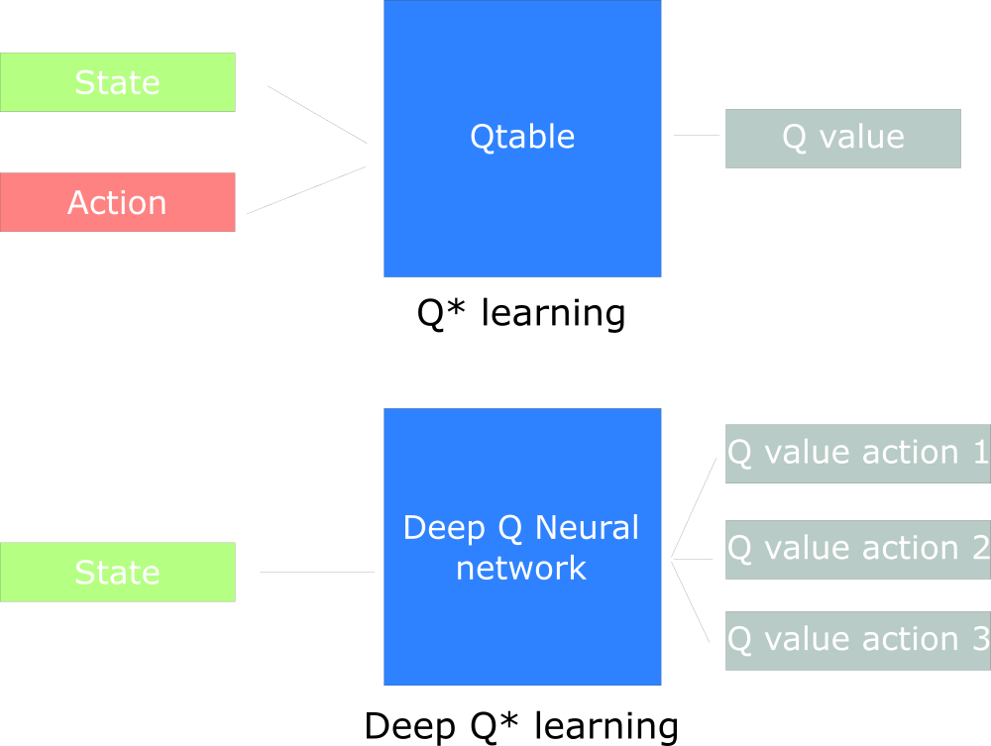

Deep Q Learning

Slide 17
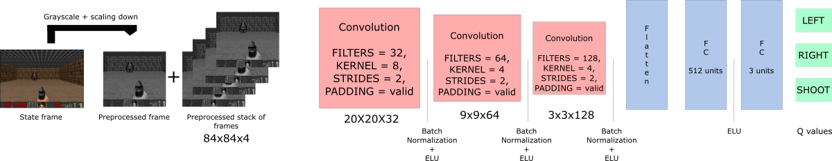

Deep Q Learning

Slide 18
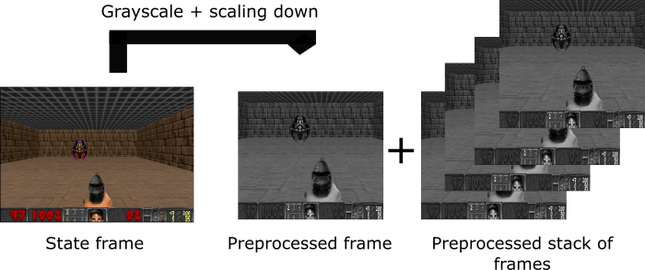


Pre-Processing and Intuition

Slide 19
AlphaGo Zero

Slide 20
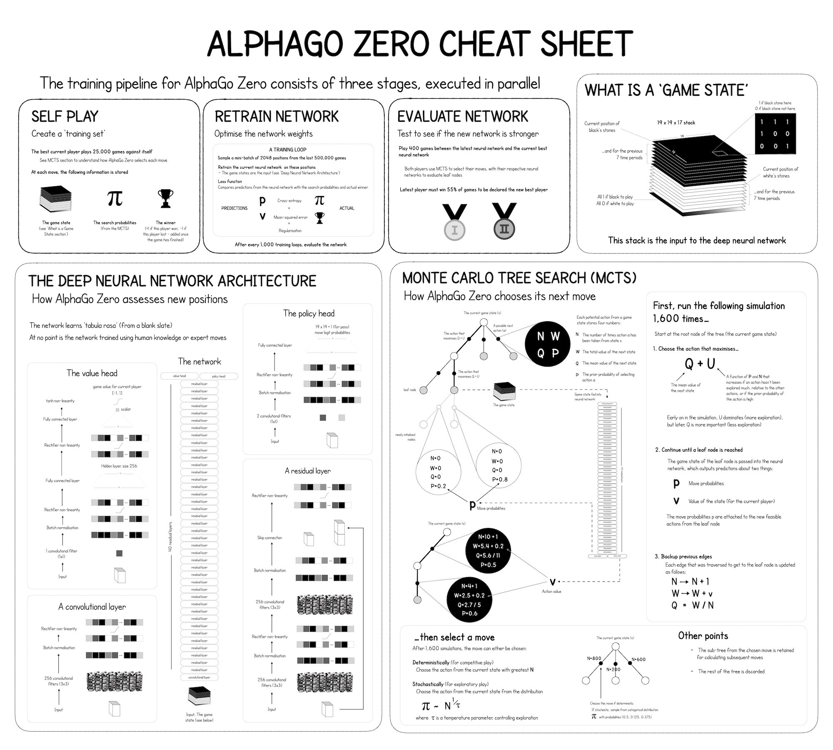

Slide 21
References
https://www.learndatasci.com/tutorials/reinforcement-q-learning-scratch-python-openai-gym/
https://skymind.ai/wiki/deep-reinforcement-learning
https://medium.freecodecamp.org/diving-deeper-into-reinforcement-learning-with-q-learning-c18d0db58efe
https://medium.freecodecamp.org/an-introduction-to-deep-q-learning-lets-play-doom-54d02d8017d8
https://medium.com/applied-data-science/alphago-zero-explained-in-one-diagram-365f5abf67e0

